Slide 1
DONOR ADVISED FUND
Notes:
**PLEASE NOTE: All Bold text is for the speaker’s use only, not to be read aloud. Thank you for preparing for this presentation.
Some slides in this presentation include *animation.* You may need to click more than once for all elements to appear.** Thank you for that introduction. I have the pleasure of speaking with you today about one of Rotary’s most convenient and flexible tools for managing your philanthropy … The Rotary Foundation Donor Advised Fund, commonly referred to as a DAF.
Let me start by saying that it really is …

Slide 2
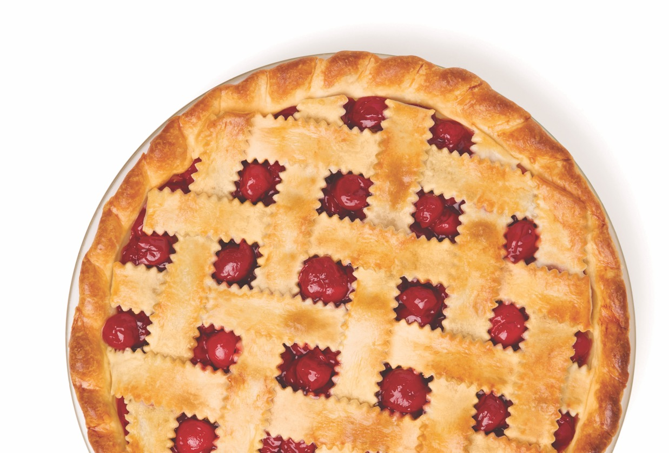
EASY AS PIE
Notes:
… EASY AS PIE … and can simplify your charitable giving.
(CLICK TO NEXT SLIDE)

Slide 3
WHAT IS A DONOR ADVISED FUND?
+
=
Give a gift. Let it grow. Make a sweet difference.
THE ROTARY FOUNDATION DONOR ADVISED FUND
Notes:
A DONOR-ADVISED FUND, or DAF, is a charitable account set up to allow donors to:
**Click for animation** make a charitable contribution and receive an immediate tax deduction,
**Click for animation** invest tax free, and
**Click for animation** recommend grants from the fund over time
Donors can contribute to the fund as frequently as they like, and then recommend grants when it makes sense for them.
(CLICK TO NEXT SLIDE)

Slide 4
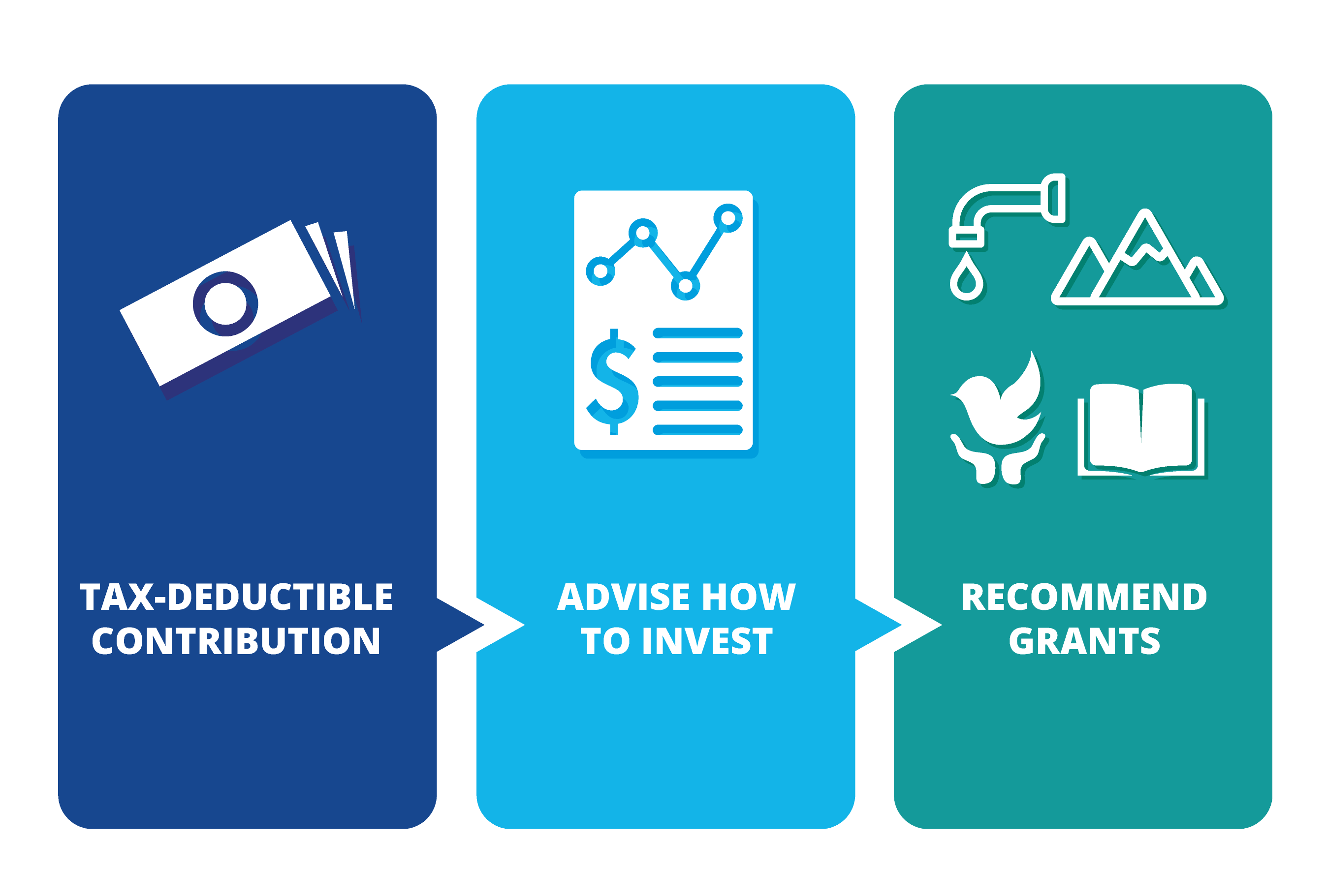
HOW A DAF WORKS
Notes:
**Click for animation**
The irrevocable contributions are held in an investment account managed by The Rotary Foundation, then granted out at a later date based upon the Account Advisor’s recommendations.
The contributions are invested in four available portfolios and have a chance to grow tax-free.
(CLICK TO NEXT SLIDE)

Slide 5
ELIGIBLE GRANTEES
IRS-approved US public charities with the same tax status as The Rotary Foundation.
Commonly referred to as 501(c)(3) public charities.
THE ROTARY FOUNDATION DONOR ADVISED FUND
Notes:
Each grant recommendation is reviewed for tax status and to ensure that the funds are not going to an impermissible purpose like funding your own child’s education, paying for dinner, or covering your auction bids.
**Click for animation**
As you see by the variety in the images depicted on this slide, grants can be made to most charitable entities that are approved by the IRS and similar to The Rotary Foundation in tax status. Approved grantees may also include religious organizations.
But Rotary doesn’t judge on the purpose of the approved charity, so if you want to support the Longhopes Donkey Shelter or the Clean Cooking Alliance you’re free to do so.
(CLICK TO NEXT SLIDE)

Slide 6
COMPETITIVE FEES
ADMINISTRATIVE SERVICES =
.70%
INVESTMENT MANAGEMENT =
.20%
Notes:
Rotary has negotiated very reasonable fees of less than 1% for all investment and administrative management from third-party partners, NRS and BNY Mellon, who’ve been with Rotary for years.
**Click for animation**
You will note that there is no fee paid to The Rotary Foundation for operating the DAF.
Rotary does have a dedicated Donor Advised Fund Specialist who can give you one-on-one assistance, which is not often found in the DAFs operated by larger commercial banks.
(CLICK TO NEXT SLIDE)

Slide 7
SUMMARY
+
=
Give a gift. Let it grow. Make a sweet difference.
THE ROTARY FOUNDATION DONOR ADVISED FUND
Notes:
Let’s summarize what we’ve learned so far:
Your contribution is tax deductible, plus
Opportunity for investment growth, equals
More meaningful grants to eligible charities.
So now that you’ve learned how easy it is – let’s discuss the different forms of using the DAF.
(CLICK TO NEXT SLIDE)

Slide 8
GROUP ACCOUNTS
THE ROTARY FOUNDATION DONOR ADVISED FUND
Notes:
Whether you want to streamline your Club’s fundraising or simplify your personal philanthropy– the DAF can help for both!
There are accounts for groups, such as a Rotary club. They function a lot like a foundation; anyone can contribute, and two- to four people are given the ability to recommend grants as Account Advisors.
Group Accounts are designed to last forever, so they are a great alternative to a club or district foundation. The group does not have to be a Rotary entity, so feel free to consider a TRF DAF for your other charitable activities.
(CLICK TO NEXT SLIDE)

Slide 9
GROUP ACCOUNT
BENEFITS & FEATURES
Support TRF’s Annual Fund with a yearly grant of 1% of the account’s value.
Immediate confirmation of contributions and on-line grants.
Consolidated quarterly account statements.
Online account access to view grant and account activity at any time.
Enable club members and others to make tax-deductible contributions.
With a DAF account, a club does not have to worry about managing the investments and the fiduciary responsibilities.
The Rotary Foundation takes care of IRS tax reporting issues, including filing the Form 990.
Avoid legal fees of establishing a 501(c)(3).
Notes:
Support TRF’s Annual Fund with a yearly grant of 1% of the account’s value.
Immediate confirmation of on-line contributions and grants.
Consolidated quarterly account statements.
Online account access to view grant and account activity at any time.
Wait, there’s more! **Click for animation**
Enable others to make tax deductible contributions to your group.
The a club does not have to worry about managing the investments and the fiduciary responsibilities.
The Rotary Foundation takes care of IRS tax reporting issues, including filing a Form 990 so that administrative burden shifts from your shoulders to ours.
Avoid the legal fees of establishing a 501(c)(3).
(CLICK TO NEXT SLIDE)

Slide 10
Maximize an existing CLUB Foundation
Reduce administrative burden by letting the DAF issue tax receipts, account for the funds on tax filings, and manage investments
Recommend grants to the club foundation as needed
Reduce tax preparation by keeping minimum assets in the club foundation
Increase professional investment resources
Notes:
If you already have a club or district foundation and feel that this doesn’t apply - think again.
**Click for animation**
A TRF DAF can make operating your local foundation even easier.
You may be able to eliminate the need to issue receipts, account for the donations in annual tax filings, manage tax preparation
You can avoid fiduciary responsibilities related to contributions, accounting, investing, reporting, you get the idea… just easier.
You can always recommend grants back to the club foundation as needed to support its charitable projects
(CLICK TO NEXT SLIDE)

Slide 11
Restrictions & disclaimers
See Program Circular for more details.
Notes:
DAF accounts do have some restrictions, which are outlined in the Program Circular. **Click for animation**
Some highlights are:
Account Advisors may not recommend a grant to an individual or for a scholarship earmarked for a particular student.
DAF funds can’t be used to pay for fundraising expenses. Payments to the DAF cannot be split between the cost of an event and the charitable portion of the gift.
Have no fear, Rotary has a dedicated DAF Specialist to help you structure gifts to the DAF.
(CLICK TO NEXT SLIDE)

Slide 12
INDIVIDUAL ACCOUNTS
Notes:
There are also accounts for individuals, so you have the benefits of a family foundation, without the hassles of operating one!
To really understand the benefits of an individual or family account, it might be better to explain the many ways that it makes philanthropy easier.
(CLICK TO NEXT SLIDE)

Slide 13
INDIVIDUAL ACCOUNT
BENEFITS
Make year-end gifts to maximize tax benefits
Make one transfer of securities to the account, then distribute from there
Access your account on-line any time
Donate taxable assets now, then recommend grants throughout your retirement years
Opt to be anonymous
Establish an account for your children or grandchildren
Reduce your estate tax
THE ROTARY FOUNDATION DONOR ADVISED FUND
Notes:
**Click for animation**
Make lump sum year-end gifts to the account to maximize tax benefits then take as much time as you need to recommend grants to your favorite charities.
Make one transfer of securities to the account, instead of making multiple smaller transfers to multiple charities, that may not have a streamlined process.
Access your account on-line, any time of day or night.
If you’re planning to retire in a few years and want to maximize tax deductions while you’re still in a taxable income bracket, you can make donations to the account now and recommend grants throughout your retirement years.
Concerned about anonymity? You can send all or any of your grants anonymously through a TRF DAF.
(CLICK TO NEXT SLIDE)

Slide 14
MORE INDIVIDUAL ACCOUNT BENEFITS
Automate your Annual Fund support with a minimum $250 transfer each July
Paul Harris Fellow and Major Donor recognition for support of TRF programs
Benefactor or Bequest Society when the account is opened
Create your Rotary Legacy:
Fifty-percent of the remaining funds transfer to Rotary’s Endowment in your name
Remaining funds may be designated for other charities
THE ROTARY FOUNDATION DONOR ADVISED FUND
Notes:
**Click for animation**
Easily support TRF programs with a minimum yearly grant of $250 to the Annual Fund
Benefactor or Bequest Society recognition when the account is opened
Paul Harris Fellow and Major Donor Recognition for grants from the DAF to TRF
(CLICK TO NEXT SLIDE)

Slide 15
EVEN MORE SWEET BENEFITS
Reduce estate taxes
Create your personal Rotary Legacy
Name children as successors for balances of $150,000 or more
Name children as successors
Establish funds for children or grandchildren
THE ROTARY FOUNDATION DONOR ADVISED FUND
Notes:
**Click for animation**
Reduce your potential estate taxes
Leave a personal legacy to the Endowment Fund:
- Half (or more) of the funds left in the account when the surviving spouse passes away will be transferred to Rotary’s Endowment.
- Remaining funds may be designated for another charity.
Establish an account for children or grandchildren so they regularly research and engage in charitable activities.
Name children as successors if the balance of the account is $150,000 or more before the transfer to the Endowment Fund.
(CLICK TO NEXT SLIDE)

Slide 16
1
GIVE A GIFT
2
LET IT GROW
3
MAKE A DIFFERENCE
Notes:
In summary, Give a gift, Let it grow, Make a difference
As you can see, the tax benefits, low fees, minimal administrative burden, and flexibility of The Rotary Foundation Donor Advised Fund make it easy to imagine how you can maximize your philanthropy. It really is ….
(CLICK TO NEXT SLIDE)

Slide 17
EASY AS PIE
Notes:
Easy as Pie! ☺
(CLICK TO NEXT SLIDE)

Slide 18
QUESTIONS?
MACKENZIE CONDON
Donor Advised Fund Specialist
T 847-866-3359
plannedgiving@rotary.org
Notes:
Do we have any questions about the TRF DAF program?
… [take questions that benefit the entire group, defer any personal questions or concerns to afterward]
Thanks for those great questions!
If you’re interested in a Donor Advised Fund, please feel free to talk to me or Rotary’s dedicated Donor Advised Fund Specialist whose information is on the screen.
There are some limitations to operating a Donor Advised Fund, so MacKenzie or a member of the Planned Giving Team will have a personal conversation with you about how you’d like to use the DAF to make sure it suits your needs.
As with any gift to charity, we recommend that you work with your personal financial and tax advisors.
Thank you. I look forward to working with you as you explore ways The Rotary Foundation can partner in your philanthropy.
(END)

Slide 19
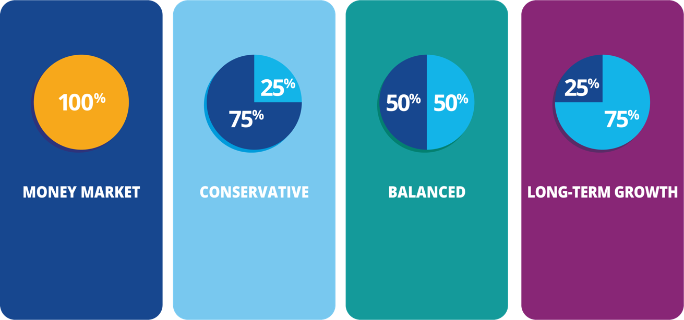
INVESTMENT OPTIONS
100% money market fund and short-term instruments
25% stock funds,
75% bond funds, and
short-term instruments
50% stock funds,
50% bond funds, and
short-term instruments
75% stock funds,
25% bond funds, and
short-term instruments
Notes:
IN CASE ANYONE ASKS, YOU CAN SHARE MORE ABOUT THE INVESTMENT OPTIONS
The Account Advisor can recommend among four portfolios how the contributions are invested.
This slide illustrates that, no matter what funds you choose, Rotary will invest these contributions responsibly without unnecessary risk.
I won’t go into the investment strategy or performance in this presentation, but if you are interested, please let me know!
(CLICK TO NEXT SLIDE)

